Slide 1
Object Oriented Programming (Classes and Objects)
Bilal jan

Slide 2
Object Oriented Programming (Classes and objects)

Slide 3
Contents
Object Oriented Programming
Classes and Objects in Java
Ways to initialize objects
Anonymous objects
Access specifier
Constructors
Types of constructors
Constructor overloading
Copy constructor

Slide 4
Object Oriented Programming
Programming languages that shape data and behavior in one unit called an object are called Object Oriented languages. A class provides an early plant a.k.a blue-print for creating objects.
As example Car is a class providing different attributes such as manufacturer, model, color, engineType etc. with functions like drive, horn, maintain etc.
The different attributes and functions are grouped into an instance of the Car class known as Object
Java is fundamentally object oriented. Every line of code you write in java must be inside a class (not counting import directives).OOP fundamental stones Encapsulation, Inheritance and Polymorphism etc. are all fully supported by java.
OOP is mythology or paradigm to design a program using class and object. OOP is paradigm that provides many concepts such as:
Class and objects
Inheritance
Modularity
Polymorphism
Encapsulation (binding code and its data) etc.

Slide 5
Object Oriented Programming
Java is fundamentally object oriented.
Every line of code you write in java must be inside a class (not counting import directives).
OOP fundamental concepts like Encapsulation, Inheritance and Polymorphism etc. are all fully supported by java.

Slide 6
Benefits of OOP
Code Reusability: Reusing existing code helps reduce development time and increase efficiency.
Improved organization: Objects encapsulate data and behavior, making it easier to understand and manage complex systems.
Abstraction: OOP helps hide complex implementation details, making it easier to use and understand.
Modularity: Objects can be treated as independent units, making it easier to isolate and modify parts of a system.
Scalability: Objects can be easily added or removed as needed, making it easier to evolve and scale a system over time.
Polymorphism: Allows objects of different classes to be treated as objects of a common class, making code more flexible and adaptable to changes.
Encapsulation: Protects the data within an object from external access, improving security and reducing the likelihood of errors.

Slide 7

Features of Java
Source https://www.javatpoint.com/features-of-java

Slide 8

Encapsulation
Encapsulation refers to the bundling of data and functions that manipulate that data within a single unit or object
Data and behaviour (function) are tightly coupled inside an object.
This makes the data within an object protected from external access and manipulation, improving the security and reducing the likelihood of errors.
Encapsulation promotes the idea of data hiding, as implementation details are hidden within the object, allowing users to interact with the object through a well-defined interface, making the code more maintainable and easier to understand.
Capsule: Stable shell used to enclose medicines.

Slide 9
Data Hiding
Data hiding is a concept in object-oriented programming (OOP) where the implementation details of an object are hidden from the outside world, and only a public interface is exposed. This helps to protect the internal data and behavior of an object from being modified or accessed inappropriately, and helps to promote the stability and maintainability of the code.
In OOP, data hiding is achieved through the use of access modifiers such as "private" or "protected". Variables and methods marked as "private" can only be accessed within the same class, while "protected" variables and methods can be accessed within the same class and by any subclasses.
By hiding the implementation details of an object, data hiding makes it easier to make changes to the object without affecting other parts of the code. This helps to improve the reliability and maintainability of the code and makes it easier to detect and resolve errors.
Java supports three access specifiers i.e. private, public and protected

Slide 10
Class
Class is blue print or map for object.
Class is the logical construct of object.
Class is the description of object.
Class is a template which contains behaviour (member functions) and attributes/properties (data/variables) of object.
Means data members and member functions are defined within a class.
Class is user defined data type because user defined it.
Attribute: properties abject has.
Methods: actions that an object can do.

Slide 11
Object
An entity that has state and behaviour.
An actual existence of a class is called object.
An object encapsulates data and behaviour.
When a class template is implemented in real world then it becomes object.
Object is the instance of the class.
Class is the template or blue print from which objects are created, so object is the instance (result) of the class.
The space reserved in memory for class.

Slide 12
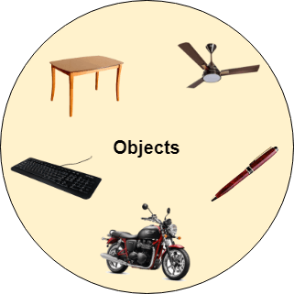
Object…
Object is used to perform responsibility of communication between different classes.
Any entity that has state and behavior is known as an object. For example, a chair, pen, table, keyboard, bike, etc. It can be physical or logical.
Example: A dog is an object because it has states like color, name, breed, etc. as well as behaviors like wagging the tail, barking, eating, etc.

Slide 13
Class VS Object
Class: No data or function. Even no memory is allocated. It is only a blue-print, an early abstract plan for the design and implementation of an object
Object: Having both data and associated functions. Memory is allocated as per need.

Slide 14
Member data and member function
Member data or data members: The data or the attributes defined within a class is called member data.
Member Function: The functions that are used to work on the data items are called member functions.
Member functions are used to process and access data members of an object.
Member functions are functions that are included within the class.

Slide 15
Instance variable in java
A variable that is created inside a class but outside a method is called instance variable.
Instance variable does not get memory at compile time.
It gets memory at runtime when an object (instance) is created. That is why it called instance variable.

Slide 16
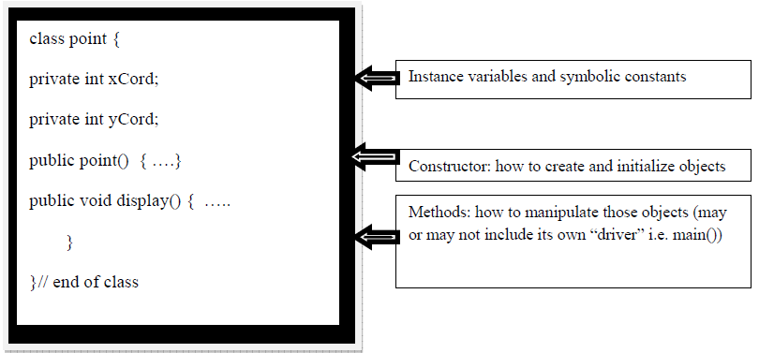
Defining a Class

Slide 17
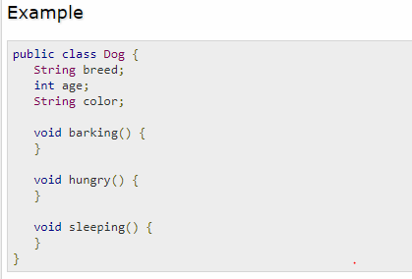
Classes and Objects
MyClass obj = new MyClass();
Note: new keyword is used for object instantiation in heap

Slide 18
Classes and Objects…
Object declaration
Student obj ; // obj is reference variable
Object instantiation
obj = new Student();
OR
Student obj = new Student();

Slide 19
How to Access member of a class
1) obj.variableName = value; // to access data member
2) obj.methodName(parameter list); // to access method
Examples
obj.rollNo = 123;
obj.getRollNo();

Slide 20
Classes and Objects…
//Java Program to illustrate how to define a class and fields
//Defining a Student class.
class Student{
//defining fields
int id; //field or data member or instance variable
String name;

Slide 21
Classes and Objects…
//creating main method inside the Student class
public static void main(String args[]){
//Creating an object or instance
Student s1=new Student(); //creating an object of Student
//Printing values of the object
System.out.println(s1.id); //accessing member through reference variable
System.out.println(s1.name);
}
}
Output:
0
null

Slide 22
Ways to initialize object
There are 3 ways to initialize object in Java.
By reference variable
By method
By constructor

Slide 23
1) Initialization through reference
Initializing an object means storing data into the object. Let's see a simple example where we are going to initialize the object through a reference variable.
Driver Class: Class which contains main method is called main Class or driver class.
class Student{
int id;
String name;
}

Slide 24
1) Initialization through reference
// driver class
class TestStudent2 {
public static void main(String args[]){
Student s1=new Student();
s1.id=101;
s1.name="Sonoo";
System.out.println(s1.id+" "+s1.name); //printing members with a white space
} }
Output
101 Sonoo

Slide 25
2) Initialization through method
In this example, we are creating the two objects of Student class and initializing the value to these objects by invoking the insertRecord method. Here, we are displaying the state (data) of the objects by invoking the displayInformation() method.

Slide 26
2) Initialization through method
class Student{
int rollno;
String name;
void insertRecord(int r, String n){
rollno=r;
name=n;
}
void displayInformation(){System.out.println(rollno+" "+name);}
}

Slide 27
2) Initialization through method…
class TestStudent4{
public static void main(String args[]){
Student s1=new Student();
Student s2=new Student();
s1.insertRecord(111,"Karan");
s2.insertRecord(222,"Aryan");
s1.displayInformation();
s2.displayInformation();
}
}
Output
111 Karan 222 Aryan

Slide 28
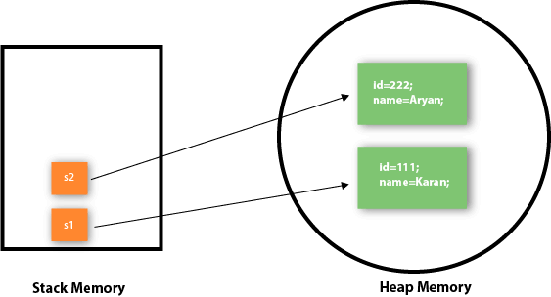
2) Initialization through method…
As you can see in the below figure, object gets the memory in heap memory area. The reference variable refers to the object allocated in the heap memory area. Here, s1 and s2 both are reference variables that refer to the objects allocated in memory.

Slide 29
2) Initialization through method…

Slide 30
3) Initialization through a constructor
class Student4{
int id;
String name;
//creating a parameterized constructor
Student4(int i,String n){
id = i;
name = n;
}
//method to display the values
void display(){System.out.println(id+" "+name);}

Slide 31
3) Initialization through a constructor…
public static void main(String args[]){
//creating objects and passing values
Student4 s1 = new Student4(111,"Karan");
Student4 s2 = new Student4(222,"Aryan");
//calling method to display the values of object
s1.display();
s2.display();
}
}
Output:
111 Karan
222 Aryan

Slide 32
Anonymous object
Anonymous simply means nameless. An object which has no reference is known as an anonymous object. It can be used at the time of object creation only.
If you have to use an object only once, an anonymous object is a good approach.
For example:
new Calculation(); //anonymous object

Slide 33
Anonymous object
Calling method through a reference:
Calculation c=new Calculation();
c.fact(5);
Calling method through an anonymous object
new Calculation().fact(5);

Slide 34
Anonymous object…
Let's see the full example of an anonymous object in Java.
class Calculation{
void fact(int n){
int fact=1;
for(int i=1;i<=n;i++){
fact=fact*i;
}
System.out.println("factorial is "+fact);
}
public static void main(String args[]){
new Calculation().fact(5); //calling method with anonymous object
} }
Output
Factorial is 120

Slide 35
Access Specifier
It specifies that member of a class is accessible outside or not. It may be public, protected or private or default.
A private member is only accessible within the same class as it is declared.
A member with no access modifier (Default ) is only accessible within classes in the same package.
A protected member is accessible within all classes in the same package and within subclasses in other packages.
A public member is accessible to all classes (unless it resides in a module that does not export the package it is declared in).

Slide 36
Access Specifier…
Private: Limited access to class only
Default (no modifier): Limited access to class and package
Protected: Limited access to class, package and subclasses (both inside and outside package)
Public: Accessible to class, package (all), and subclasses

Slide 37
Access Specifier Table
Access Modifier | within class | within package | outside package by subclass only | outside package
Private | Y | N | N | N
Default | Y | Y | N | N
Protected | Y | Y | Y | N
Public | Y | Y | Y | Y

Slide 38
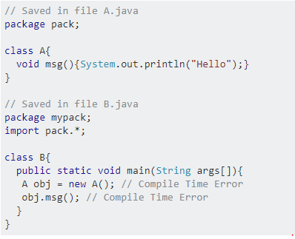
Access Specifier… (default)

Slide 39
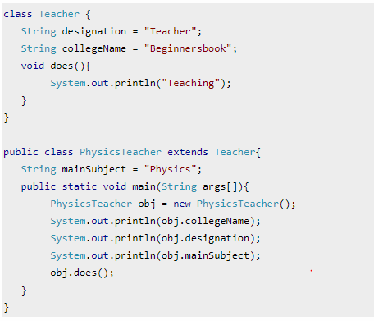
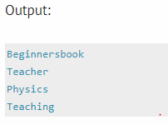
Access Specifier… (default)

Slide 40
Program 01: Data member and member functions
package classes_objects_constructors; // pakage name
public class Student {
int rollNo;
String name;
public void setRollNo(int rno)
{
rollNo = rno;
}

Slide 41
Program 01: Data member and member functions
public int getRollNo()
{
return rollNo;
}
public void setName(String n)
{
name = n;
}

Slide 42
Program 01: Data member and member functions
public String getName()
{
return name;
}

Slide 43
Program 01: Data member and member functions
public String toString()
{
return "Roll No is:" +rollNo + "\n" +"Name is:" +name;
}
} // Student Class body closed

Slide 44
Program 01: Data member and member functions
Main Class: Class which contains main method is called main class or driver class.
package classes_objects_constructors;
public class StudentTest {
public static void main(String[] args) {
Student s= new Student();
System.out.println(s.getRollNo()); // This will show "0" because no argument is passed
System.out.println(s.getName()); // This will show "null" because no argument is passed

Slide 45
Program 01: Data member and member functions
System.out.println("\nAfter Passing Arguments to Functions\n");
s.setRollNo(150535);
s.setName(“Rizwan Ullah");

Slide 46
Program 01: Data member and member functions
System.out.println("Roll Number is: "+s.getRollNo()); // This will show "150535" because argument is passed
System.out.println("Name is: " +s.getName()); // This will show “Rizwan Ullah" because argument is passed
/*System.out.println(s); /*this will just print object reference because "tostring()" function is not defined in student class */

Slide 47
Program 01: Data member and member functions
System.out.println("\nAfter defininig toString() Function in Student Class\n");
System.out.println(s); //this will call toString function
//System.out.println(s.toString()); // This will also call toString() Function
System.out.println("");
Student s2 = new Student();
s2.setRollNo(150509);
s2.setName("Sami Ullah");
System.out.println(s2);
}
} // StudentTest class body closed

Slide 48
Program 01: Data member and member functions
Note
When we write it in main class “ System.out.print(s); ”
This will print reference of an object “s” on screen because toString() function is not defined in student class, means in that class whose object has been created.
After defining function :
public String toString()
{
return (which thing do you want to return);
}

Slide 49
Program 01: Data member and member functions
System.out.println(s);
It will call toString() function and will display RollNo and name of object s.
Means it will display member data of object.
System.out.print(s.toString()); This will also call toString function.
toString() function
Doing object representation.
Used for combo boxes.

Slide 50
Constructor
Special method that is implicitly invoked.
Used to create an object (an instance of the class) and initialize it.
Every time an object is created using the new() keyword, at least one constructor is called.
It is special member function having same name as class name and is used to initialize object.

Slide 51
Constructor…
It is invoked/called at the time of object creation.
It constructs value i.e. provide data for the object that is why it called constructor.
Can have parameter list or argument list.
Can never return any value (no even void).

Slide 52
Constructor…
Normally declared as public.
At the time of calling constructor, memory for the object is allocated in the memory.
It calls a default constructor if there is no constructor available in the class. In such case, Java compiler provides a default constructor by default.

Slide 53
Constructor…
Note: It is called constructor because it constructs the values at the time of object creation. It is not necessary to write a constructor for a class. It is because java compiler creates a default constructor if your class doesn't have any.

Slide 54
Rules for creating Java constructor
There are some rules defined for the constructor.
Constructor name must be the same as its class name
A Constructor must have no explicit return type.
A Java constructor cannot be abstract, static, final, and synchronized.

Slide 55
Type of Java constructor
There are two types of constructors in Java:
Default constructor (no-arg constructor)
Parameterized constructor

Slide 56
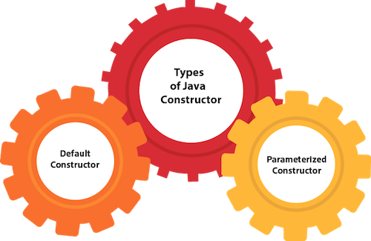
Type of Java constructor…

Slide 57
1) Java Default Constructor
A constructor is called "Default Constructor" when it doesn't have any parameter.
It is also called non-parameterized constructor.
Syntax of default constructor:
Access Specifier className()
{
}

Slide 58
Java Default Constructor Example
In this example, we are creating the no-arg constructor in the Bike class. It will be invoked at the time of object creation.
//Java Program to create and call a default constructor
class Bike1{
Bike1() //creating a default constructor
{
System.out.println("Bike class object created");
} //constructor body

Slide 59
Java Default Constructor Example…
public static void main(String args[]){ //main method
//calling a default constructor
Bike1 b=new Bike1();
}
}

Slide 60
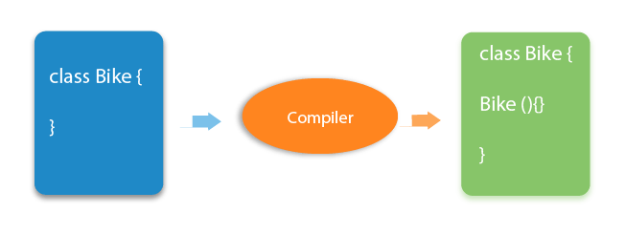
Java Default Constructor
Rule: If there is no constructor in a class, compiler automatically creates a default constructor.

Slide 61
What is the purpose of a default constructor ?
The default constructor is used to provide the default values to the object like 0, null, etc., depending on the type.

Slide 62
Example of default constructor that displays the default values
//Let us see another example of default constructor which displays the default values
class Student3{
int id;
String name;
//method to display the value of id and name
void display(){
System.out.println(id+" "+name);
}

Slide 63
Example of default constructor that displays the default values
public static void main(String args[]){
//creating objects
Student3 s1=new Student3();
Student3 s2=new Student3();
//displaying values of the object
s1.display();
s2.display();
}
} // Student3 class body closed

Slide 64
Example of default constructor that displays the default values
Output:
0 null
0 null
Explanation:
In the above class, you are not creating any constructor so compiler provides you a default constructor.
Here 0 and null values are provided by default constructor.

Slide 65
2) Java Parameterized Constructor
A constructor which has a specific number of parameters is called a parameterized constructor.
Why use the parameterized constructor?
The parameterized constructor is used to provide different values to distinct objects. However, you can provide the same values also.
Used to initialize objects with different values.

Slide 66
Example of parameterized constructor
In this example, we have created the constructor of Student class that have two parameters. We can have any number of parameters in the constructor.
class Student4{
int id;
String name;
//creating a parameterized constructor
Student4(int i,String n){
id = i;
name = n;
}
//method to display the values
void display(){System.out.println(id+" "+name);}

Slide 67
Example of parameterized constructor…
public static void main(String args[]){
//creating objects and passing values
Student4 s1 = new Student4(111,"Karan");
Student4 s2 = new Student4(222,"Aryan");
//calling method to display the values of object
s1.display();
s2.display();
}
} // Student4 class body closed
Output:
111 Karan
222 Aryan

Slide 68
Constructor Overloading
In Java, a constructor is just like a method but without return type. It can also be overloaded like Java methods.
Constructor overloading in Java is a technique of having more than one constructor with different parameter lists.
They are arranged in a way that each constructor performs a different task. They are differentiated by the compiler by the number of parameters in the list and their types.

Slide 69
Constructor Overloading…
When we have more than one constructors in a class with different set of parameters i.e. (type, number, order).

Slide 70
Example of Constructor Overloading
//Java program to overload constructors
class Student5{
int id;
String name;
int age;
//creating two argument constructor
Student5(int i,String n){
id = i;
name = n;
}

Slide 71
Example of Constructor Overloading…
//creating three arg constructor
Student5(int i,String n,int a){
id = i;
name = n;
age=a;
}
void display() { System.out.println(id+" "+name+" "+age); }

Slide 72
Example of Constructor Overloading…
public static void main(String args[]){
Student5 s1 = new Student5(111,"Karan");
Student5 s2 = new Student5(222,"Aryan",25);
s1.display();
s2.display();
}
}
Output:
111 Karan 0
222 Aryan 25

Slide 73
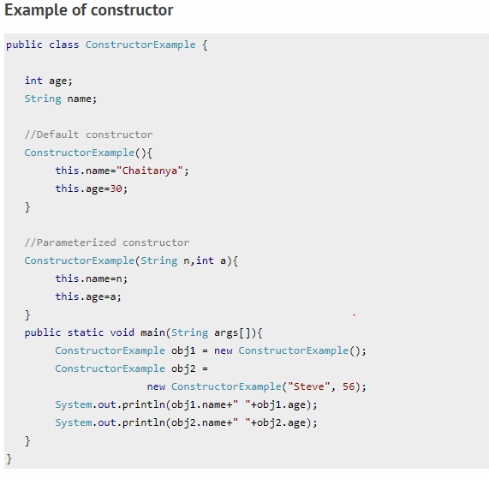
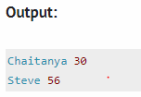
Example of Constructor

Slide 74
Destructor
Destructors are not required in java class because memory management is the responsibility of JVM.

Slide 75
Copy Constructor
A copy constructor in a Java class is a constructor that creates an object using another object of the same Java class.
That's helpful when we want to copy a complex object that has several fields, or when we want to make a deep copy of an existing object.

Slide 76
Copy Constructor…
There is no copy constructor in Java. However, we can copy the values from one object to another like copy constructor in C++.
There are many ways to copy the values of one object into another in Java. They are:
By constructor
By assigning the values of one object into another
By clone() method of Object class
In this example, we are going to copy the values of one object into another using Java constructor.

Slide 77
Copy Constructor Example 1
// This program is about copy constructor and will copy values of one object into another
package classes_objects_constructors;
public class Student6
{
int id;
String name;
Student6(int i,String n)
{
id = i;
name = n;
}

Slide 78
Copy Constructor Example 1…
Student6(Student6 s) // copy constructor
{
id = s.id;
name =s.name;
}
void display()
{
System.out.println("Id is:" + id +"\nName is:" + name);
}

Slide 79
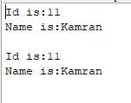
Copy Constructor Example 1…
public static void main(String args[])
{
Student6 s1 = new Student6(11,"Kamran");
Student6 s2 = new Student6(s1); // Values of s1 will be copied to s2
s1.display();
System.out.println("");
s2.display();
}
} // Student6 class body closed

Slide 80
Copy Values without constructor
We can copy the values of one object into another by assigning the objects values to another object.
In this case, there is no need to create the constructor.

Slide 81
Example
package classes_objects_constructors;
public class Student7
{
int id;
String name;
Student7(int i,String n)
{
id = i;
name = n;
}

Slide 82
Example
Student7() // default constructor
{ }
void display()
{
System.out.println("Id is:" + id +"\nName is:" + name);
}

Slide 83
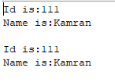
Copy Constructor Example 2…
public static void main(String[] args)
{
Student7 s1 = new Student7(111,"Kamran");
Student7 s2 = new Student7();
s2.id=s1.id;
s2.name=s1.name;
s1.display();
System.out.println("");
s2.display();
}
}

Slide 84
Defining a Student class
The following example will illustrate how to write a class. We want to write a “Student” class that
• Should be able to store the following characteristics of student
Roll No
Name
• Provide default, parameterized and copy constructors
• Provide standard getters/setters (discuss shortly) for instance variables
• Make sure, roll no has never assigned a negative value i.e. ensuring the correct state of the object
• Provide print method capable of printing student object on console

Slide 85
Getters / Setters
The attributes of a class are generally taken as private or protected. So to access them outside of a class, a convention is followed knows as getters & setters.
These are generally public methods.
The words set and get are used prior to the name of an attribute.
Another important purpose for writing getter & setters to control the values assigned to an attribute.

Slide 86
Student Class Code
// File Student.java
public class Student {
private String name;
private int rollNo;
// Standard Setters
public void setName (String name) {
this.name = name;
}

Slide 87
Student Class Code…
// Note the masking of class level variable rollNo
public void setRollNo (int rollNo)
{
if (rollNo > 0)
{
this.rollNo = rollNo;
}else {
this.rollNo = 100; }
}

Slide 88
Student Class Code…
// Standard Getters
public String getName ( ) {
return name;
}
public int getRollNo ( ) {
return rollNo;
}
// Default Constructor
public Student() {
name = “not set”;
rollNo = 100;
}

Slide 89
Student Class Code…
// parameterized Constructor for a new student
public Student(String name, int rollNo) {
setName(name); //call to setter of name
setRollNo(rollNo); //call to setter of rollNo
}
// Copy Constructor for a new student
public Student(Student s) {
name = s.name;
rollNo = s.rollNo;
}

Slide 90
Student Class Code…
// method used to display method on console
public void print () {
System.out.print("Student name: " +name);
System.out.println(", roll no: " +rollNo); }
} // end of Student class

Slide 91
Using a Class
Objects of a class are always created on heap using the “new” operator followed by constructor
• Student s = new Student ( ); // no pointer operator “*” between Student and s
• Only String constant is an exception
String greet = “Hello” ; // No new operator
However you can also use
• String greet2 = new String(“Hello”);

Slide 92
Using a Class…
Members of a class (member variables and methods also known as instance
variables/methods) are accessed using “.” operator. There is no “−>” operator in java
• s.setName(“Ali”);
• s−>setName(“Ali”) // is incorrect and will not compile in java
Note: Objects are always passed by reference and primitives are always passed by value in java.

Slide 93
Using a Class…
• Create objects of student class by calling default parameterize and copy constructor.
• Call student class various methods on these objects.

Slide 94
Student client code
// File Test.java
/* This class create Student class objects and demonstrates how to call various methods on objects
*/
public class Test{
public static void main (String args[]) {
// Make two student objects
Student s1 = new Student("ali", 15);
Student s2 = new Student(); //call to default costructor

Slide 95
Student client code…
s1.print(); // display ali and 15
s2.print(); // display not set and 100
s2.setName("usman");
s2.setRollNo(20);
System.out.print("Student name:" + s2.getName());
System.out.println(" rollNo:" + s2.getRollNo());
System.out.println("calling copy constructor");
Student s3 = new Student(s2); //call to copy constructor

Slide 96
Student client code…
s2.print();
s3.print();
s3.setRollNo(-10); //Roll No of s3 would be set to 100
s3.print();
} //end of main
} //end of class
/*NOTE: public vs. private
A statement like "b.rollNo = 10;" will not compile in a client of the Student class when rollNo is declared protected or private */

Slide 97
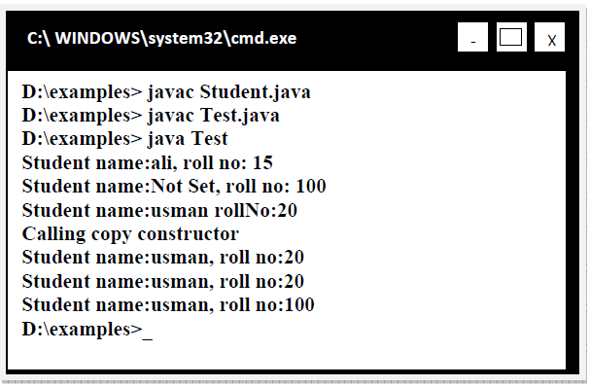
Compile & Execute

Slide 98

THANK YOU

